Slide 1

INSURANCE POLICY MANAGEMENT

Slide 2
Team Members
Employee Id | Employee Name
2490265 | Naveen Agarwal
2491290 | Saloni Barde
2490230 | Gadi Rundha
2491470 | Linga BharatKumar
2490242 | Pooja HD
2490960 | Rajat Kumar

Slide 3
INDEX
Introduction
Project Scope
Tools & Technologies
ER Diagram
Admin Module
User Module
Output

Slide 4
INTRODUCTION
The insurance company needs to keep track of details of its policyholders, their policy details and the data available with it. It is very difficult to handle bulk data since human memory is not enough and also paper work consumes lot of time. The Insurance management system is a complete solution, which will be able to manage insurance policies.
In this system, User can purchase insurance policy according to their need. For purchase plan user has to register in system. After registration user can purchase insurance plan based on price and conditions, which helps the customers to compare various plans.
Admin panel contains add-edit categories, policies, and also can approve and reject the policies.

Slide 5
PROJECT SCOPE
This project “Insurance Policy Management” makes the task faster and easy. This is used to manage records.
The system is used to keep the record of policy details, customers details.
Insurable Interest
Contribution
Proximate cause
Policy insurance

Slide 6
TECHNOLOGIES
Front end: Asp .Net MVC, HTML & CSS
Back-end: SQL Server
Server Side: IIS

Slide 7

Login
View/Delete Policy
Approve Policy
User
Admin
View Policy
Apply Policy

Slide 8
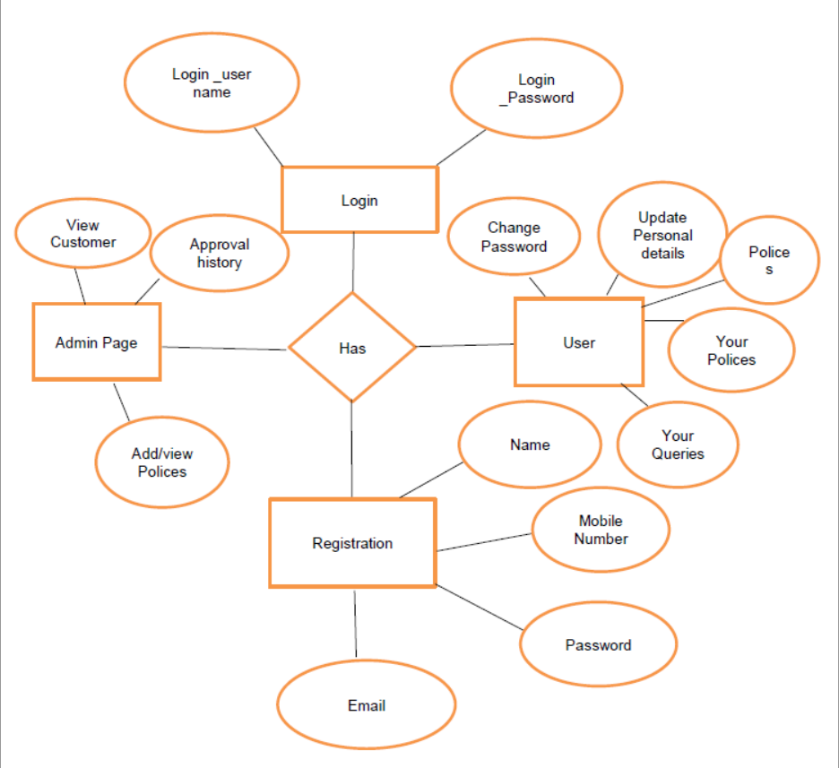

Slide 9


Modules
ADMIN
USER

Slide 10
ADMIN MODULE
Login in to portal
View Customers.
View/Add/Update/Delete policy category like Life, Health, vehicle.
View/Add/Update/Delete policy.
Approve/Disapprove policy, applied by customer.
View total policy holder, approved policy holder, disapproved policy holder.
Answer Customer Questions

Slide 11
USER MODULE
Create Account.
Login.
Password.
Raise queries.
Update Personal details.
View policy and apply.

Slide 12
FUTURE SCOPE
Developed to be used by the all the people
Can be used by the students for study purpose.
It eradicates the fake policy providing websites.
Keeps the capability to centralize all the insurance industry in India and shall keep transparency in industry.

Slide 13
CONCLUSION
By the implementation of this website, there shall be a transparency in the field of insurance industry and will help in the centralization of the insurance taking policies.
By using this application, insurance organizations will be able to reach the customers directly.
The customers can easily check with the various policies, compare them and enroll to the desired one.
This helps to increase business.

Slide 14
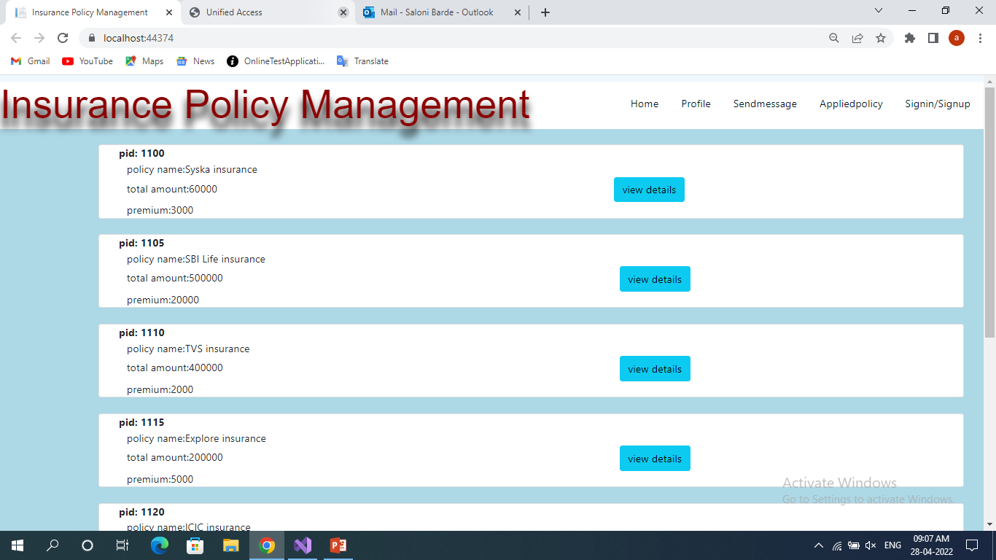
Outputs:

Slide 15
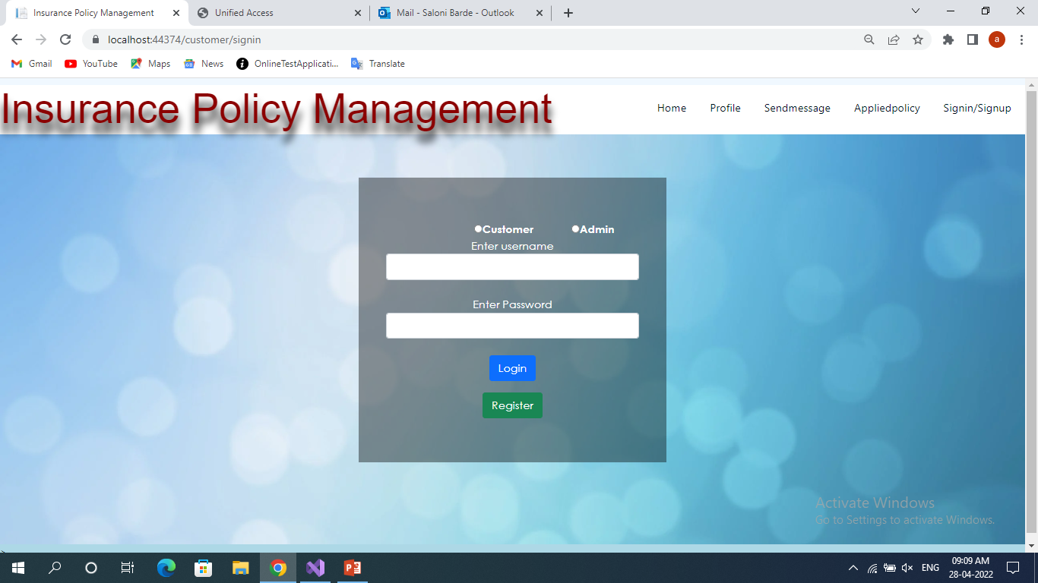

Slide 16
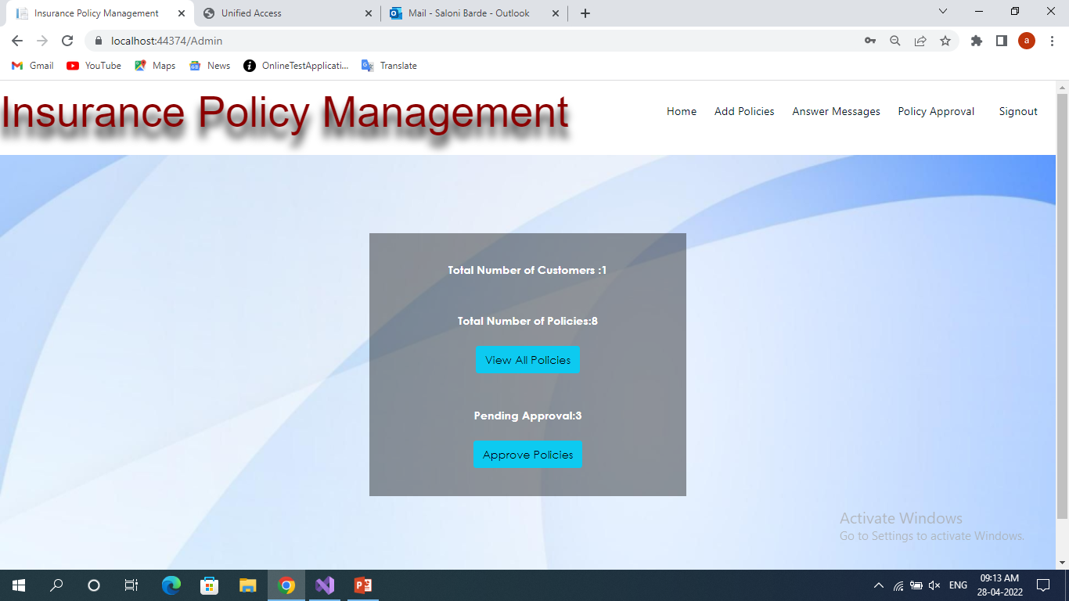

Slide 17
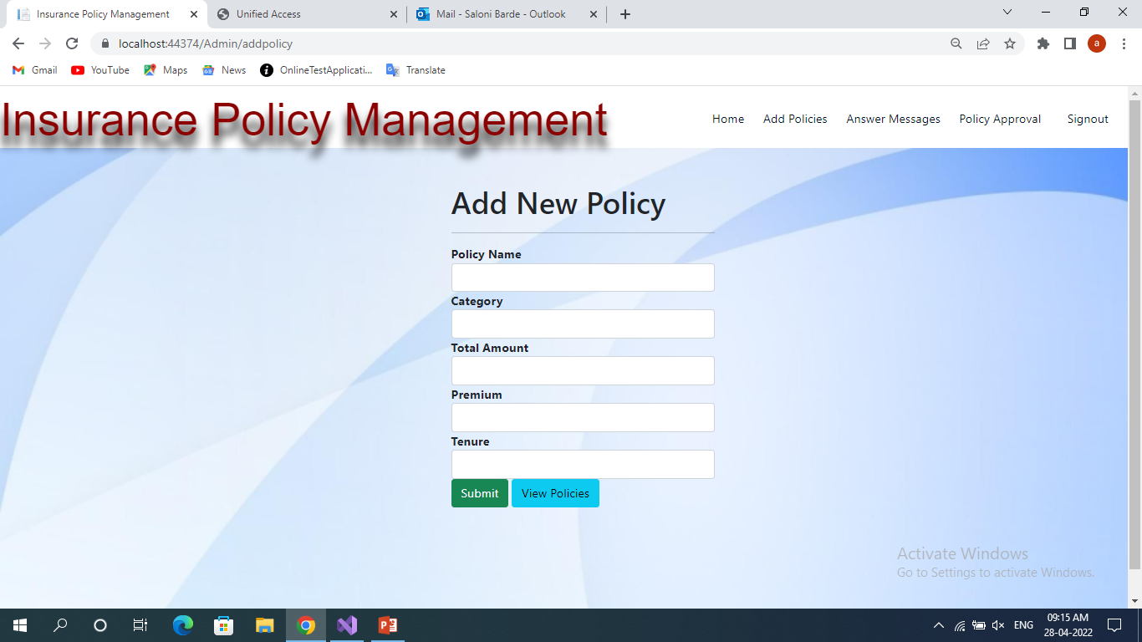

Slide 18
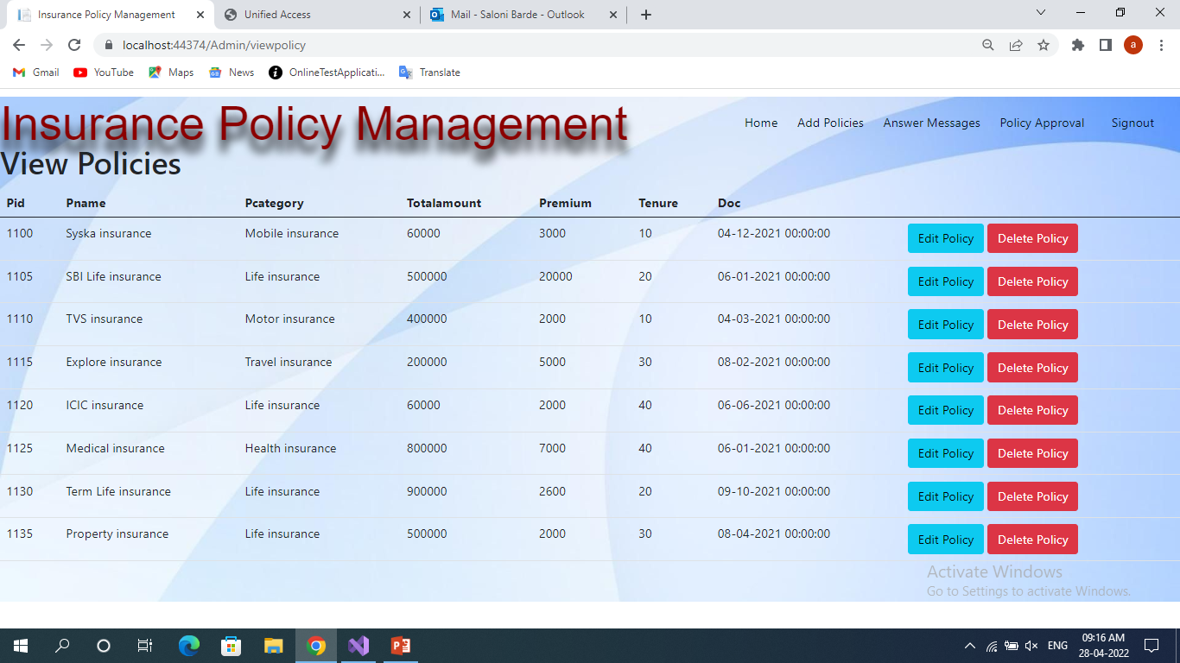

Slide 19
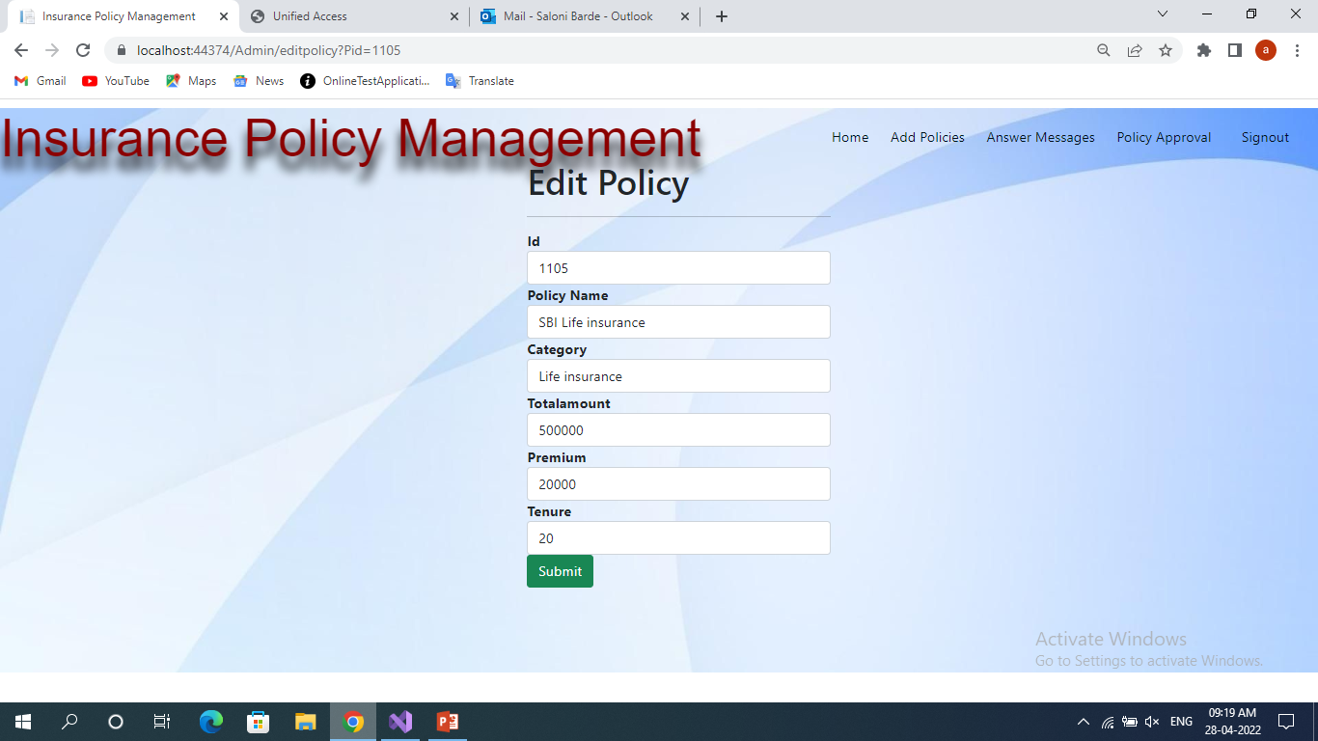

Slide 20
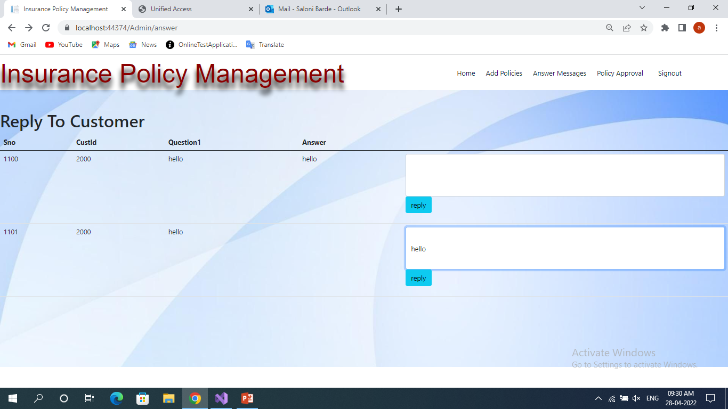

Slide 21
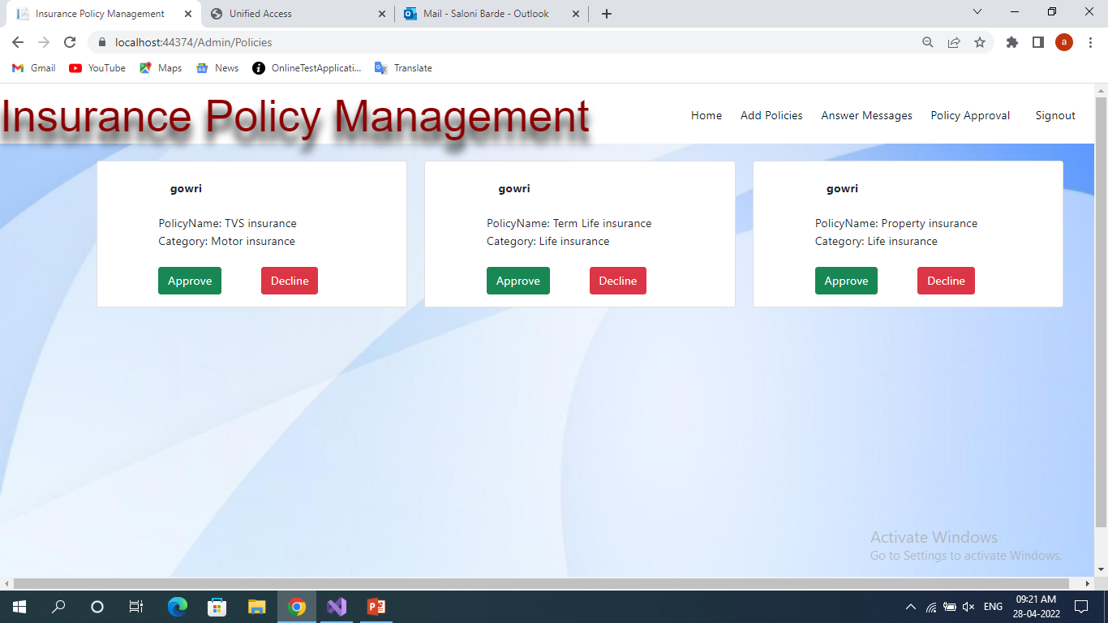

Slide 22
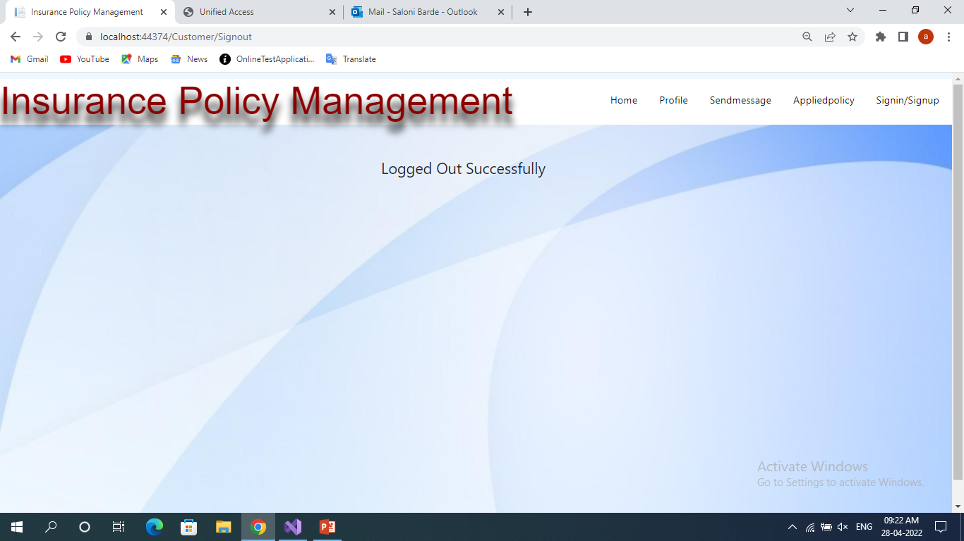

Slide 23
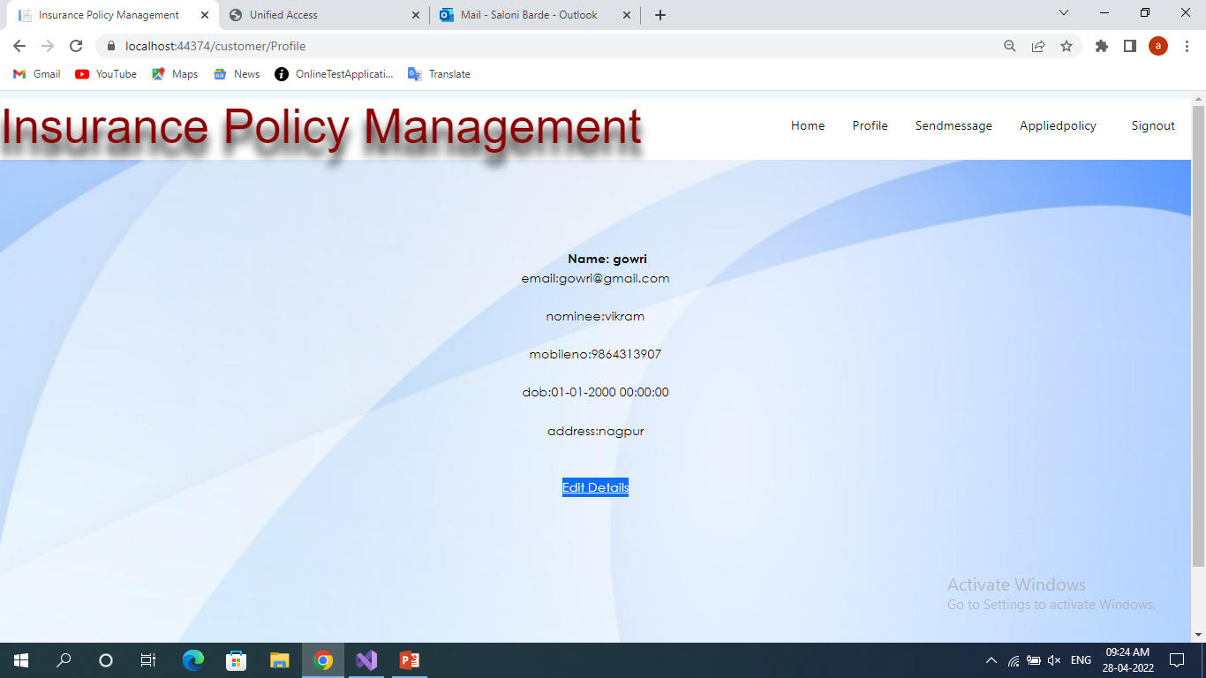

Slide 24
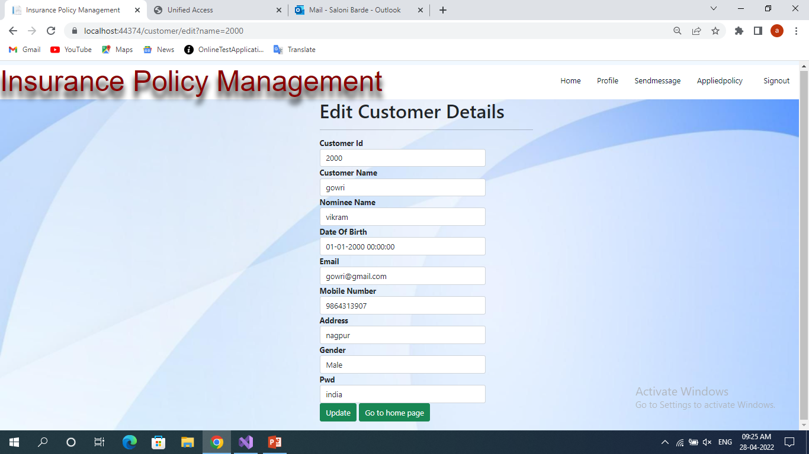

Slide 25
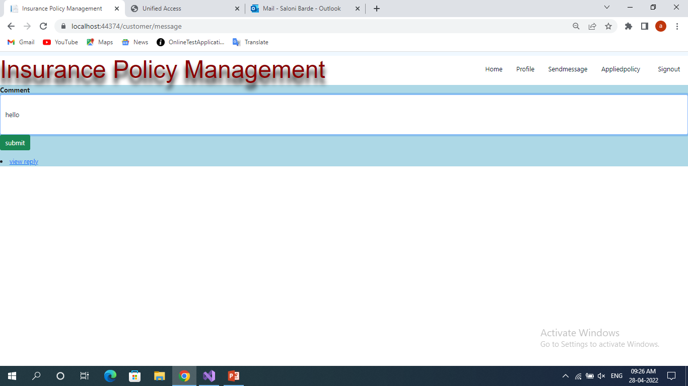

Slide 26
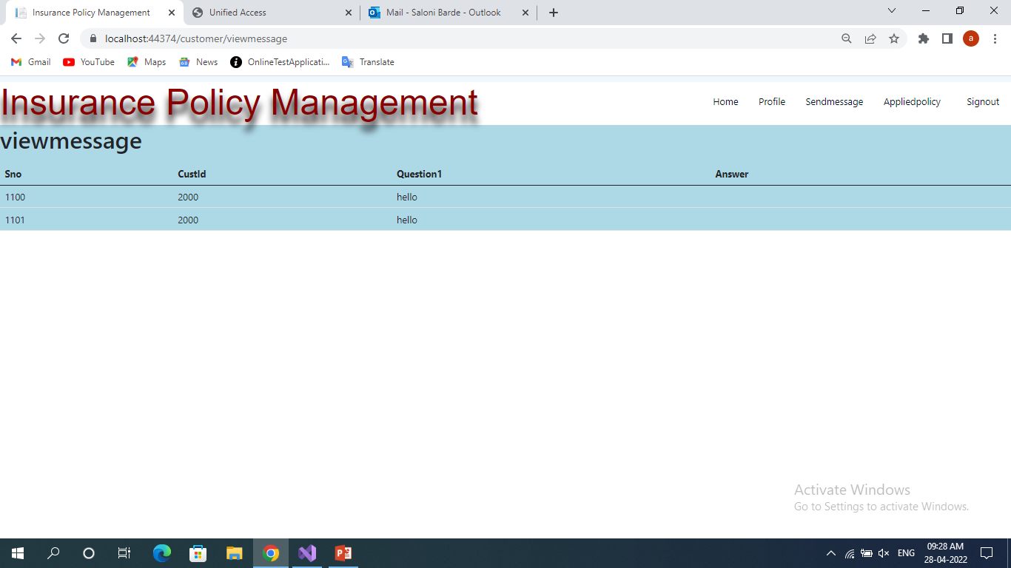

Slide 27
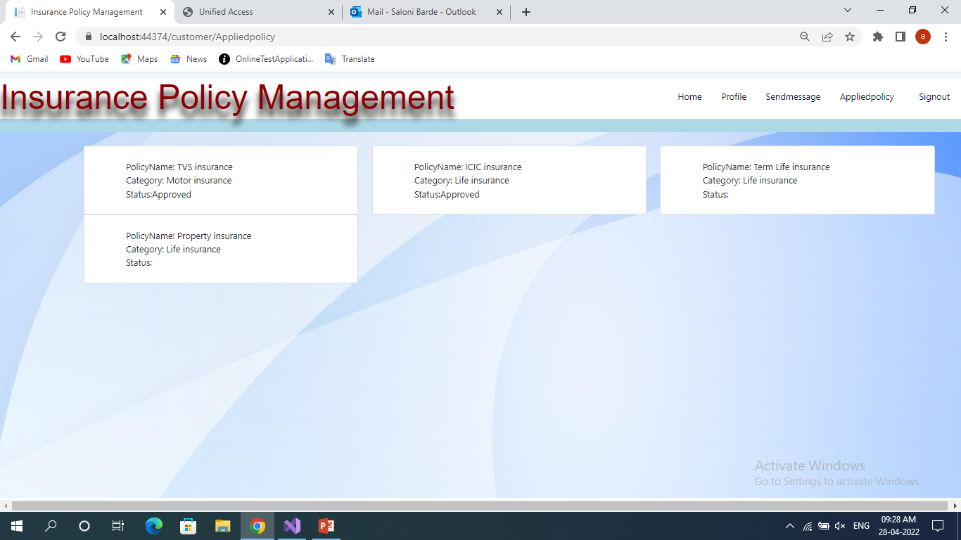

Slide 28
THANK YOU

